Slide 1

PREDICTING OBJECT DYNAMICS FROM IMAGE SEQUENCES: A PRECURSOR TO AUTONOMOUS OBJECT MANIPULATION
UTHIRALAKSHMI . S (119005122)
B. Tech. EEE
Host Institute:
University of Lincoln, UK

Slide 2

Name of the Mentor: Harit Pandya
Designation of Mentor: Research Fellow
Name of the Lab: Lincoln center for autonomous systems
Duration of stay: 5 months

Slide 3

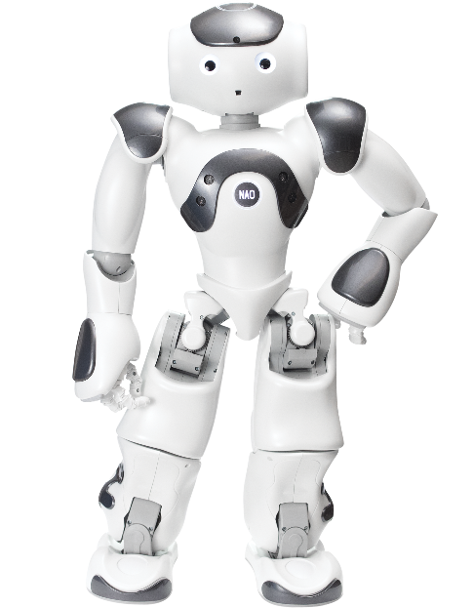
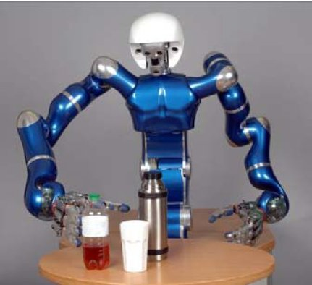
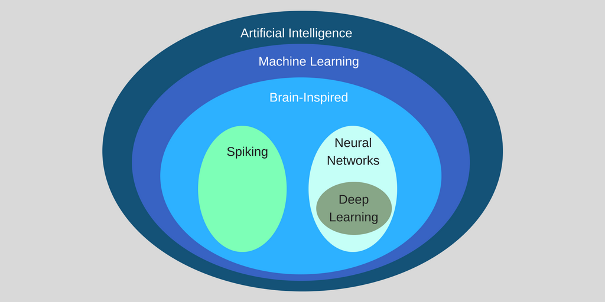
INTRODUCTION
Robotics
Robotic manipulation
Intelligent Robot manipulation
Artificial Intelligence
Machine learning
Neural Networks
References: www.google.com

Slide 4
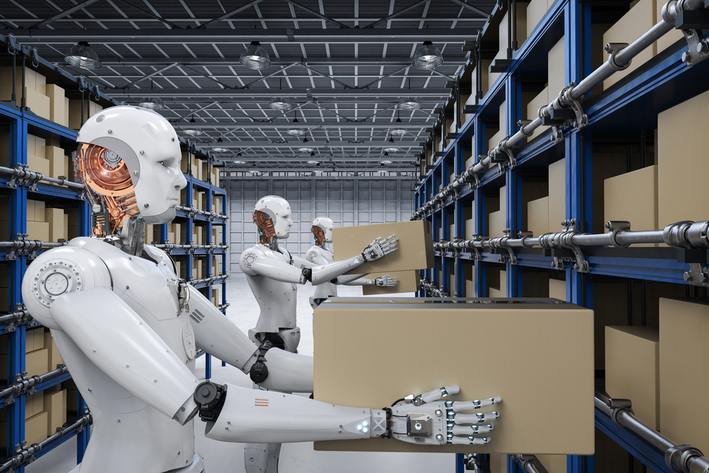
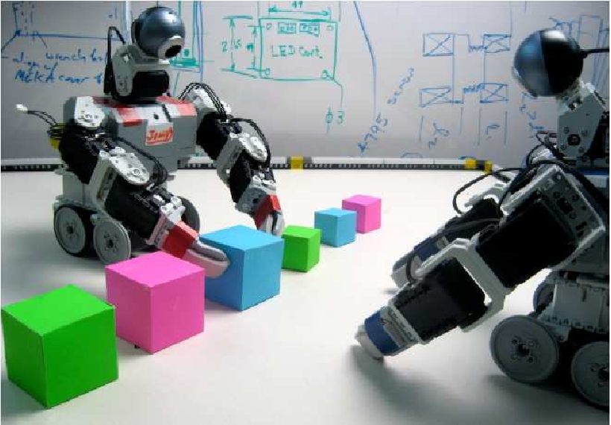
MOTIVATION
Robot Interaction with the environment
Robots – Factories, Workshops, Nuclear environment
Ability to predict the possible state of the object and interact with it
References: www.google.com

Slide 5
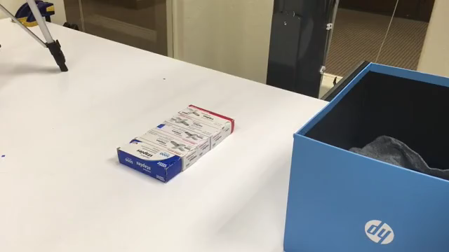
AUTONOMOUS OBJECT MANIPULATION
Reference: Andy Zeng Visual pushing and grasping using reinforcement learning

Slide 6
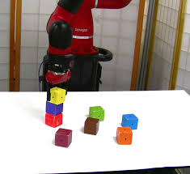
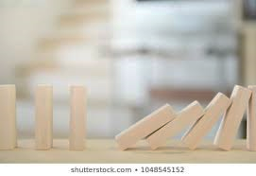
OBJECTIVE
To understand the interaction of a Robotic arm with its environment by understanding the underlying physics of simulation environment
To manipulate the Robotic arm to build and break a tower of blocks by grasping and pushing the boxes
To record images containing the pose and orientation of the boxes during the process of building and breaking of tower
To train and test a Recurrent neural network to predict the future possible state of the blocks using the images recorded
References: www.google.com

Slide 7
PREREQUISITES
Understanding of concepts in Robotics
Understanding of Recurrent neural networks and training
Understanding of ROS,GAZEBO,VREP concepts
Basic knowledge of Python programming, Image processing

Slide 8
PROJECT FLOW
NEURAL NETWORK TUTORIALS
ROS TUTORIALS
GAZEBO TUTORIALS
ROBOT SIMULATION IN GAZEBO
IMAGE DATASET RECORDING
TRAINING WITH LSTM NETWORK
ROBOT SIMULATION IN
VREP
PROJECT COMPLETION
REPORT

Slide 9
PROJECT FLOW
%

Slide 10
METHODOLOGY
SIMULATION
ROS, Gazebo, Vrep Simulation installation and setup
Importing Franka Emika Panda robot
Setting up the joints, links, initial parameters, controllers, dynamic properties
Programming the push and grasp actions of the robot by controlling the panda gripper
PREDICTION
Recording images containing pose and orientation of boxes
Training with LSTM Neural network
Calculating prediction accuracy using Image segmentation and annotating image labels

Slide 11
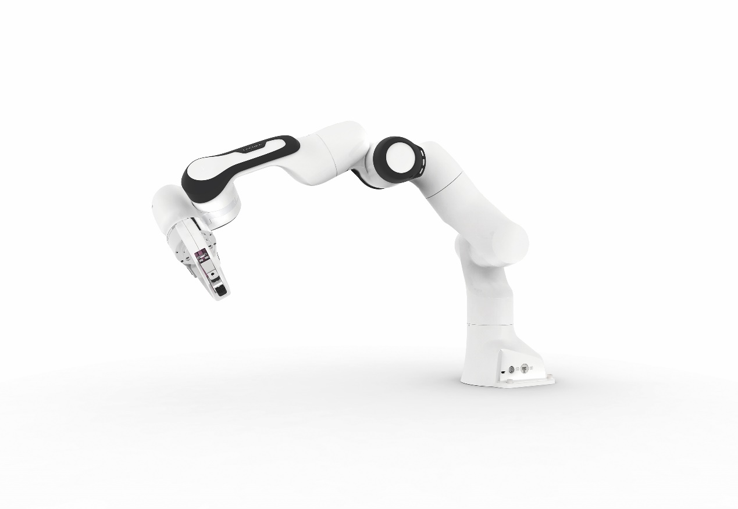
FRANKA EMIKA PANDA ROBOT
Reference: https://www.franka.de/

Slide 12
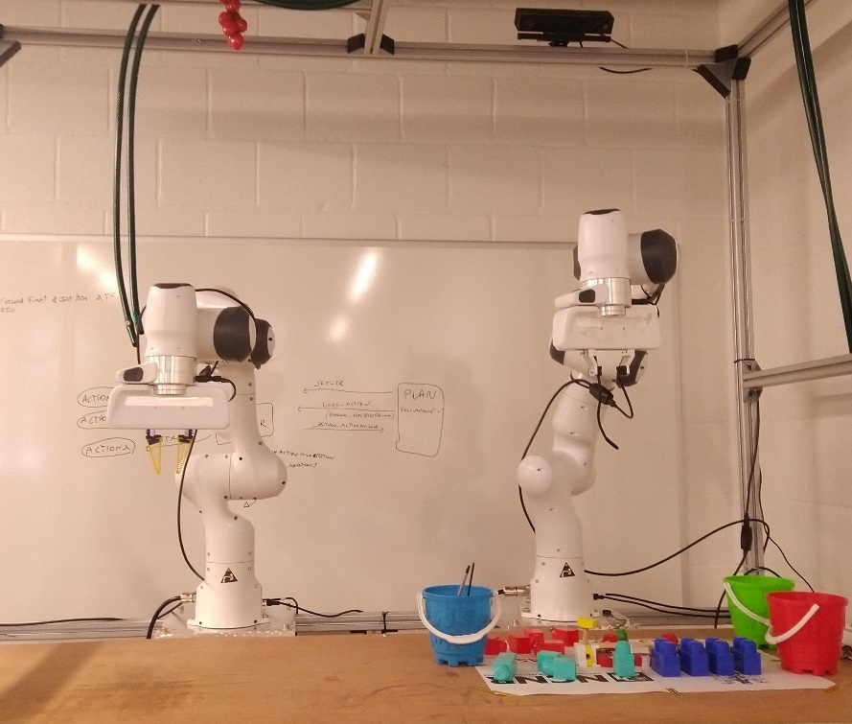
FRANKA PANDA SETUP

Slide 13
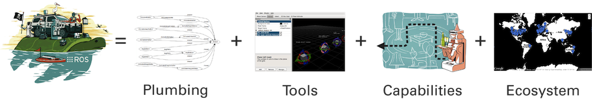
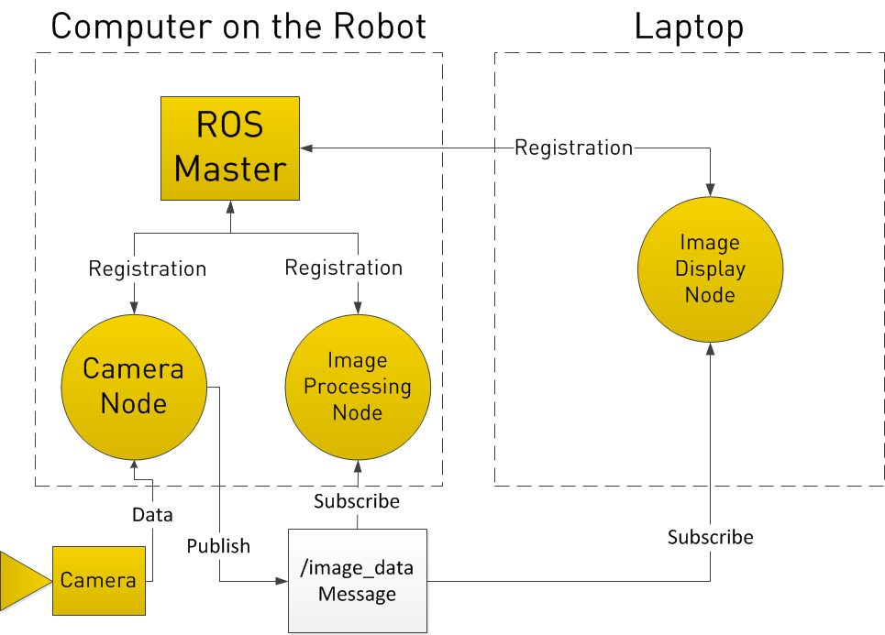
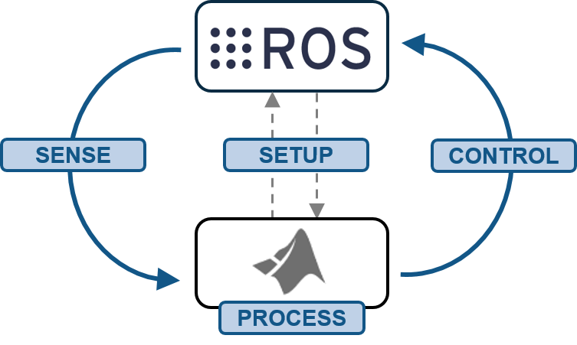
ROBOT OPERATING SYSTEM
Reference: http://wiki.ros.org/

Slide 14
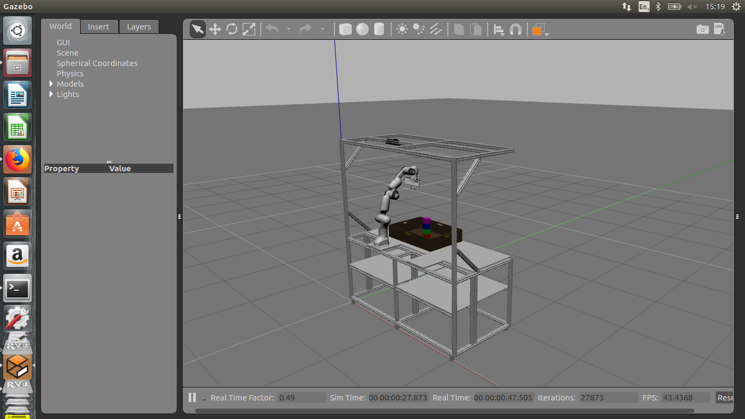
FRANKA PANDA IN GAZEBO

Slide 15
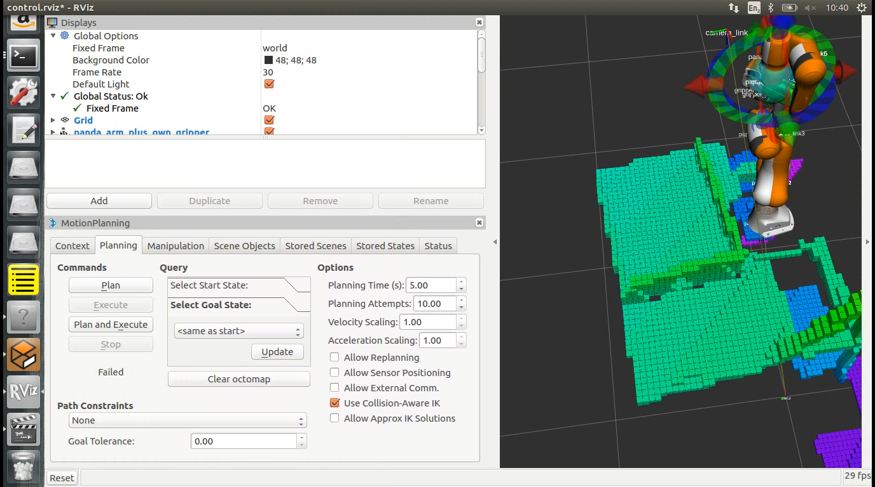
GAZEBO and RVIZ

Slide 16
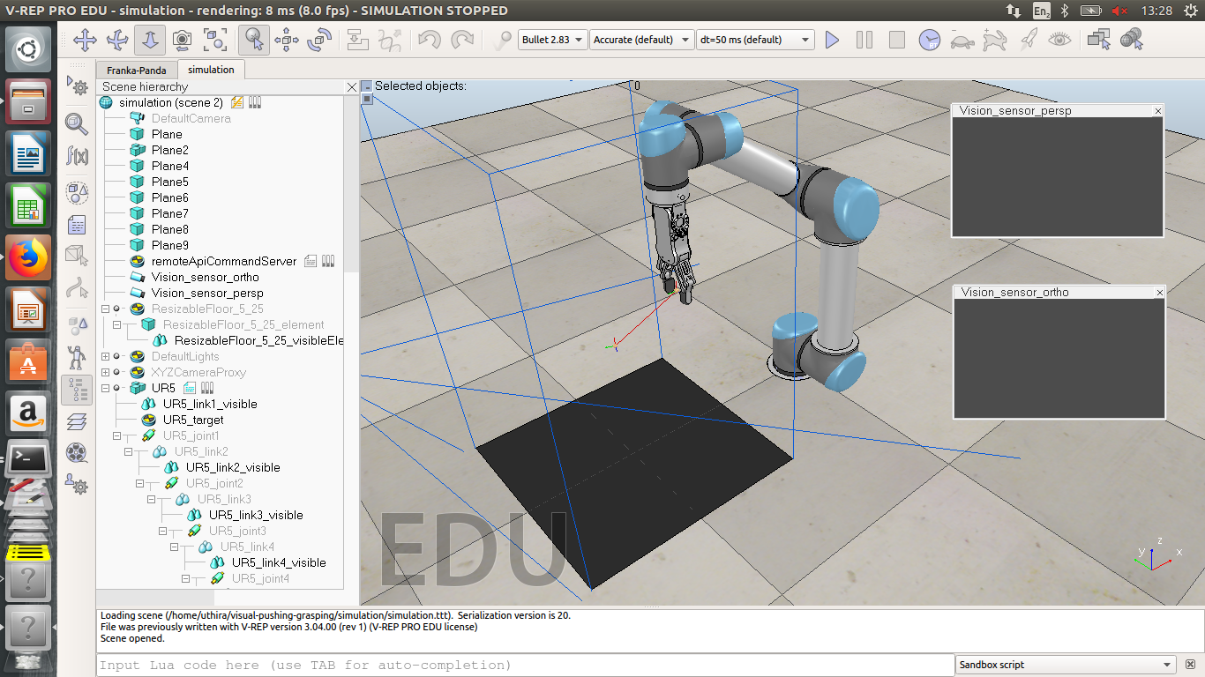
UR5 IN VREP

Slide 17
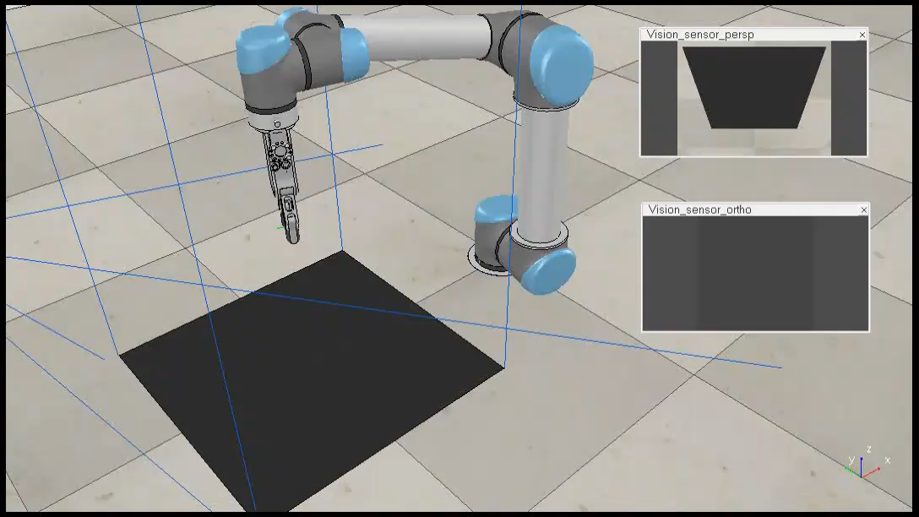
UR5 ROBOT BUILDING TOWER AND BREAKING

Slide 18
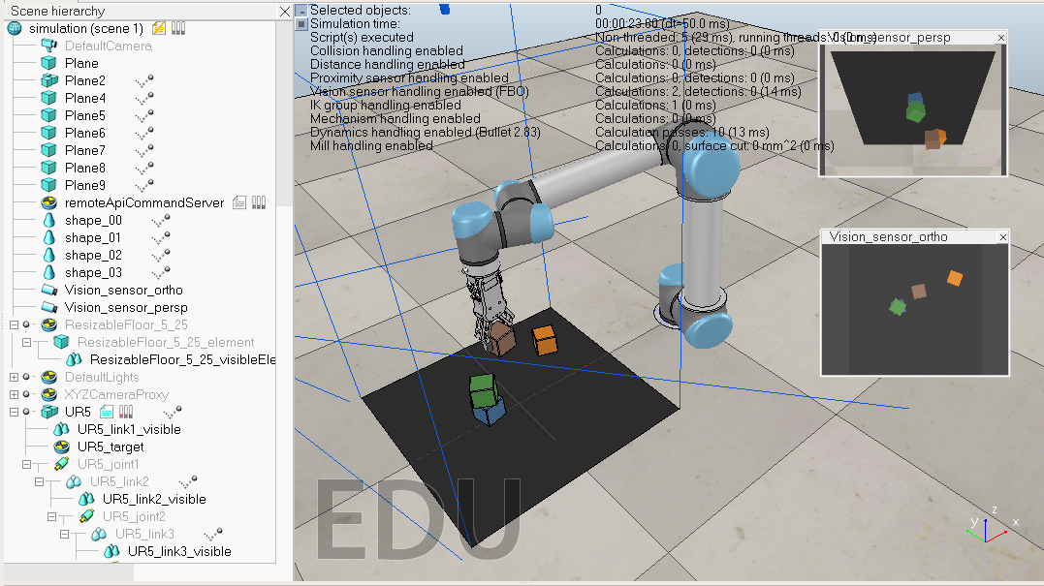
BUILDING AND BREAKING
GRASP FUNCTION
OPEN THE GRIPPER
MOVE THE GRIPPER TO THE POSITION OF THE BOX
CLOSE THE GRIPPER TILL BOX IS INSIDE THE GRIPPER
MOVE THE GRIPPER ABOVE THE POSITION
MOVE THE GRIPPER TO POSITION ON TOP OF BASE BOX
OPEN GRIPPER TO PLACE THE BOX

Slide 19
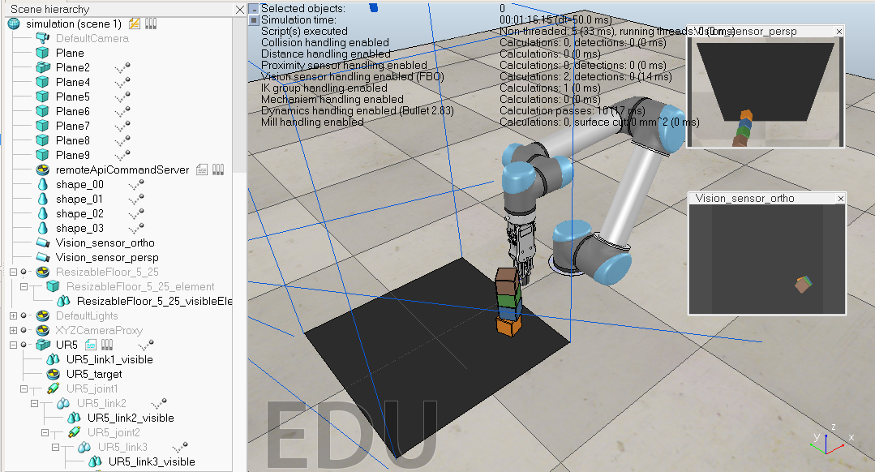
BUILDING AND BREAKING
PUSH FUNCTION
MOVE THE GRIPPER NEAR TO THE TOWER
MOVE THE GRIPPER TOWARDS THE DIRECTION OF THE TOWER

Slide 20
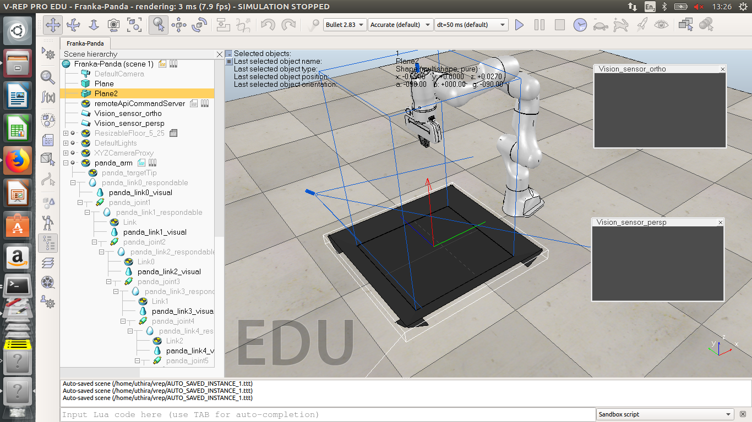
FRANKA PANDA IN VREP

Slide 21
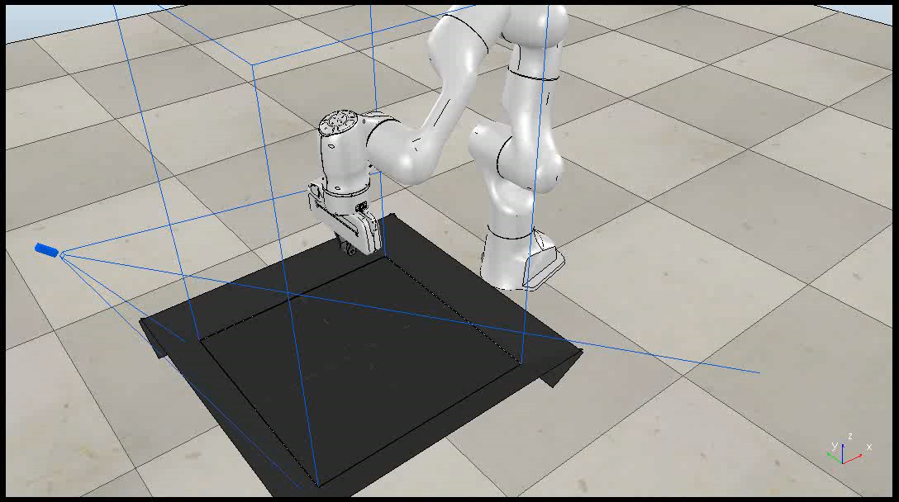
FRANKA PUSHING IN VREP

Slide 22
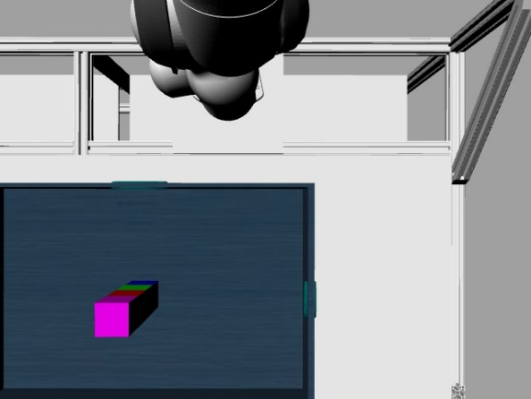
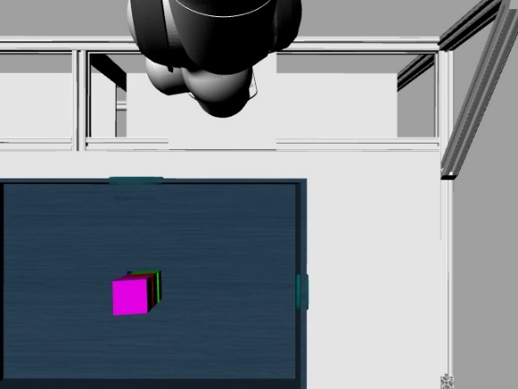
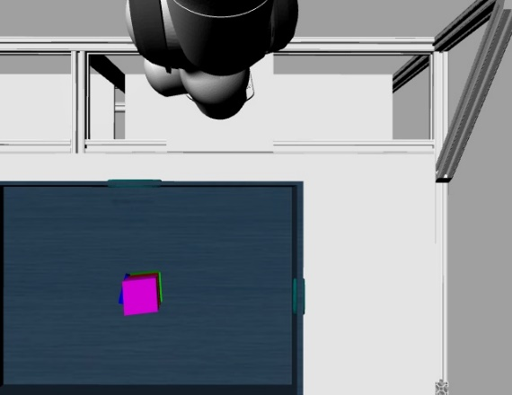

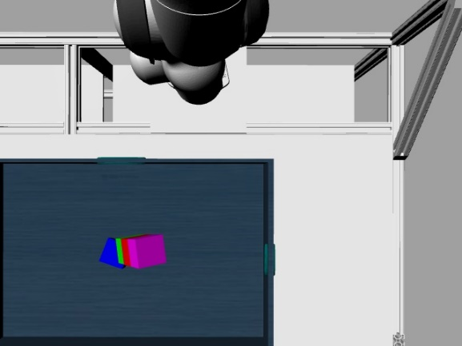

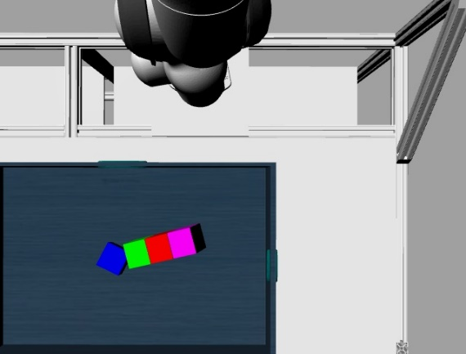
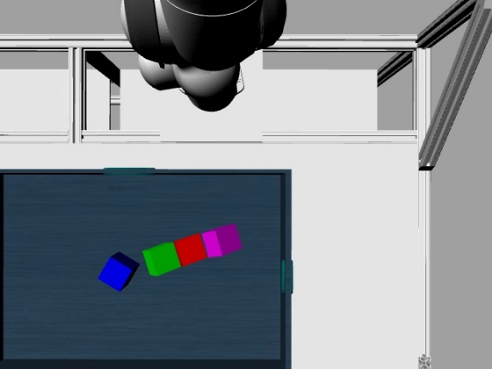
DATASET

Slide 23
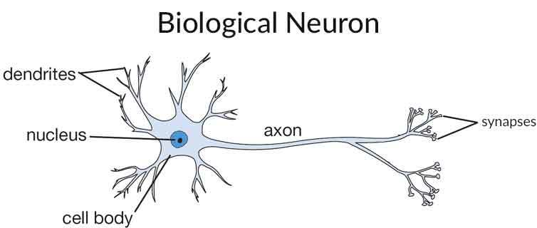

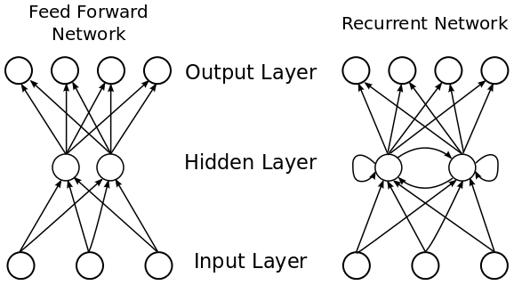
SEQUENCE PREDICTION WITH NEURAL NETWORK
Fig. 1
Fig. 2
References: Fig 1,2 http://cs231n.github.io/
Fig 3 www.researchgate.net
Fig. 3

Slide 24
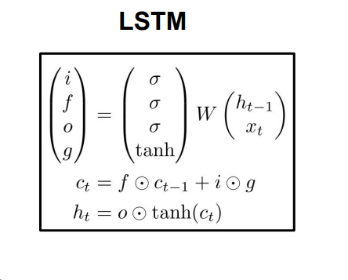
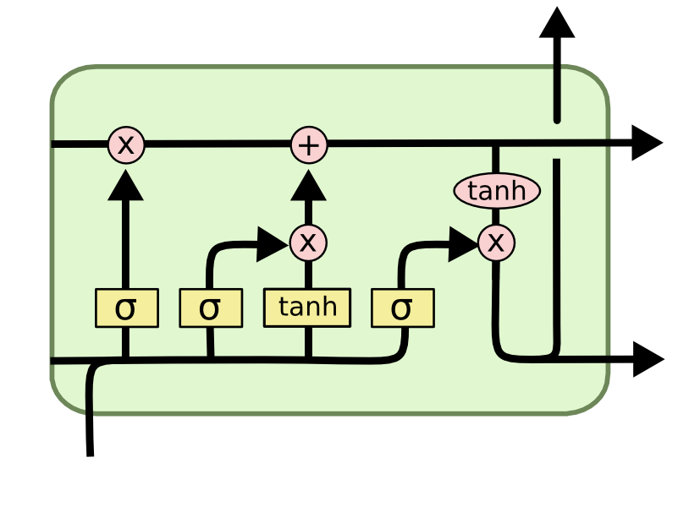
LSTM
Reference: colah.github.io

Slide 25
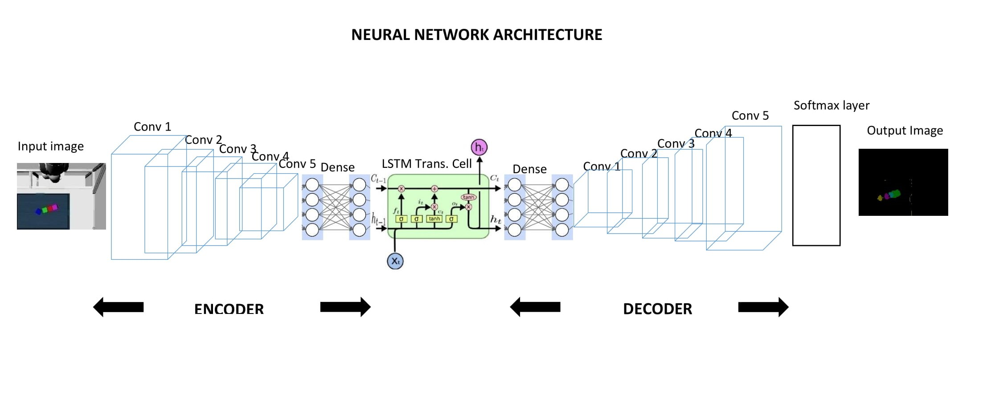
NEURAL NETWORK ARCHITECTURE
Reference: LSTM cell - colah.github.io

Slide 26
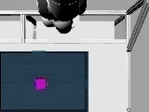
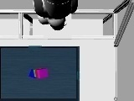
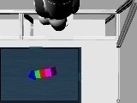
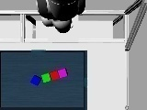

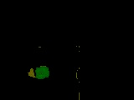
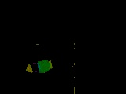

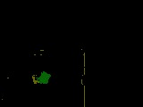
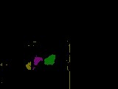
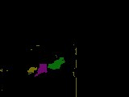
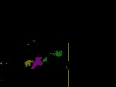
PREDICTION RESULTS
OBSERVATIONS
LABELS
PREDICTIONS

Slide 27
SUMMARY
CS231n convolutional neural network lectures ☑
ROS, Gazebo, Vrep tutorials ☑
Simulating Franka robot work cell assembly in Gazebo ☑
Building and breaking a tower of blocks in Gazebo ☑
Simulating UR5 robot in Vrep ☑
Building and breaking a tower of blocks with UR5 ☑
Simulating Franka robot work cell assembly in Vrep ☒
Building and breaking a tower of blocks with Franka ☒
Recording image dataset as the tower of blocks are being broken ☑
Train and test the dataset using LSTM based neural network architecture ☑
Train and test the dataset using advanced version of LSTM based neural network architecture ☒
Combine simulation and prediction to achieve self learning of Franka robot in simulation ☒
Implement self learning of Franka robot in real time ☒

Slide 28
FUTURE SCOPE
Predicting the sequences using advanced versions of Long short term memory network
Learning Push, Grasp actions using Reinforcement learning algorithms
Implementing building and breaking of tower in real time

Slide 29
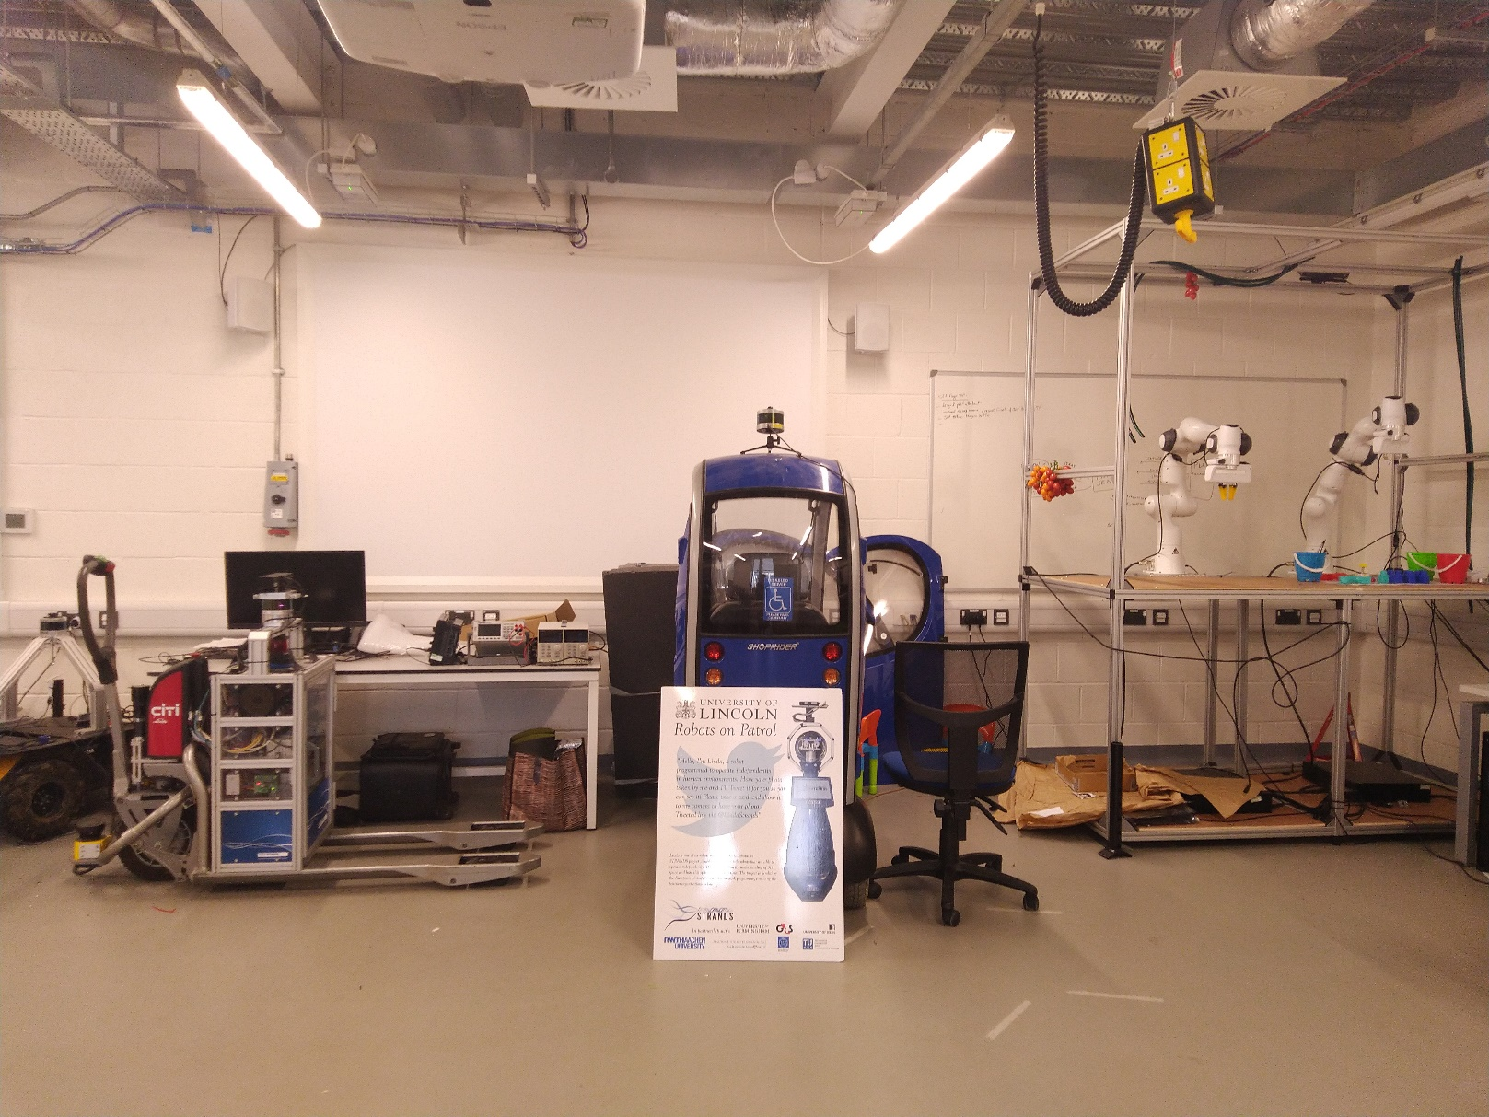
Workplace at the Host Institute/Lab

Slide 30
THANK YOU !

